Slide 1


Heart Disease Classification
Members :
Dương Đình Thắng (Leader)
Dương Nguyễn Thuận
Hoàng Ngọc Bá Thi
Phan Minh Nhật

Slide 2

Content
Dataset Introduction
Modelling
Conclusion

Slide 3
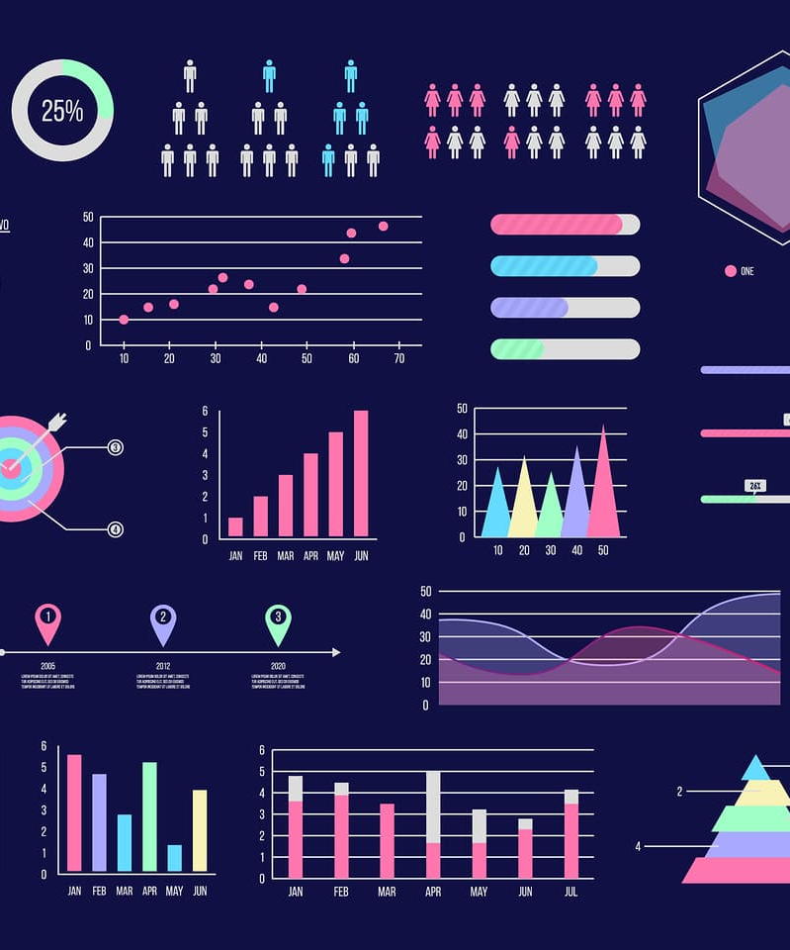
Dataset Introduction
Data: Heart Disease Cleveland UCI [1]
From: Kaggle

Slide 4
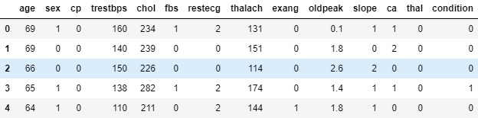
Represent and describe data
The data includes 297 instances and 13 features
❗ There are not so many data in this dataset

Slide 5
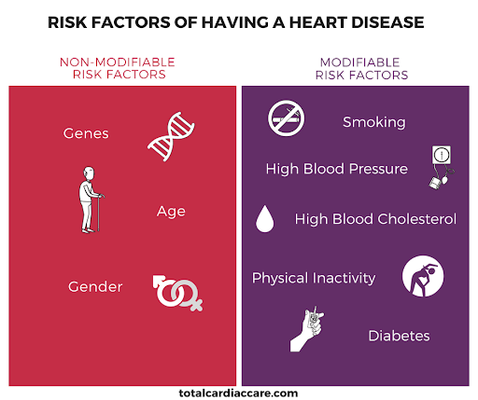
Age
Sex:
0: Female
1: Male
Chest Pain Type:
0: Typical Angina
1: Atypical Angina
2: Non-Anginal Pain
3: Asymptomatic
Resting Blood Pressure: person’s resting blood pressure.
Cholesterol: Serum Cholesterol in mg/dl
Fasting Blood Sugar:
0:Less Than 120mg/ml
1: Greater Than 120mg/ml
Resting Electrocardiographic Measurement:
0: Normal
1: ST-T Wave Abnormality
2: Left Ventricular Hypertrophy

Slide 6
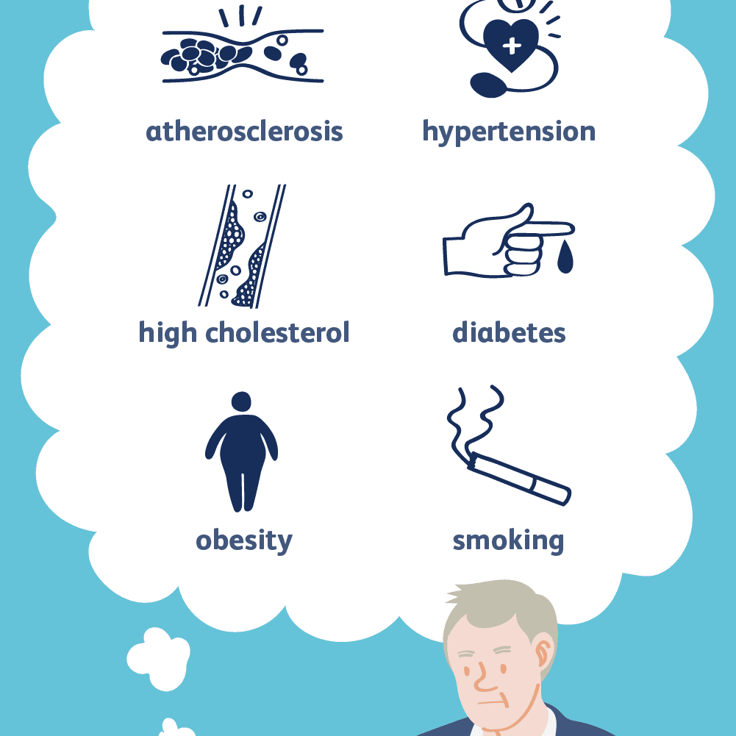
Max Heart Rate Achieved: Maximum Heart Rate Achieved
Exercise Induced Angina:
1: Yes
0: No
ST Depression: ST depression induced by exercise relative to rest.
Slope: Slope of the peak exercise ST segment:
0: Upsloping
1: Flat
2: Downsloping
Thalassemia: A blood disorder called 'Thalassemia':
0: Normal
1: Fixed Defect
2: Reversible Defect
Number of Major Vessels: Number of major vessels colored by fluoroscopy.

Slide 7
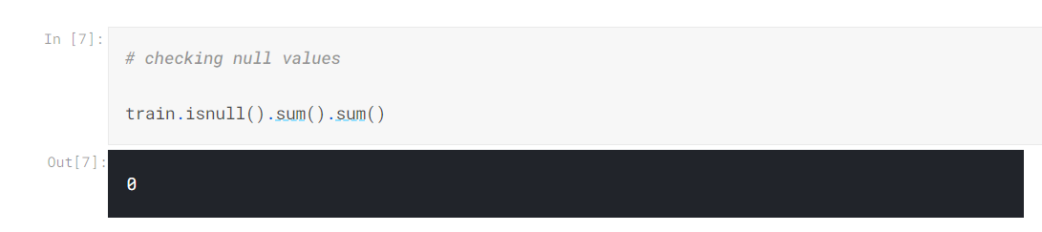
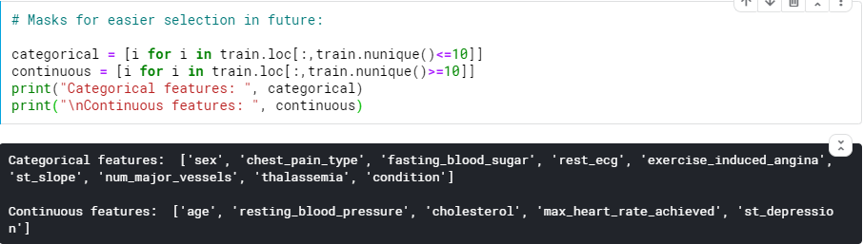
Check null
Check categorical and numerical data

Slide 8
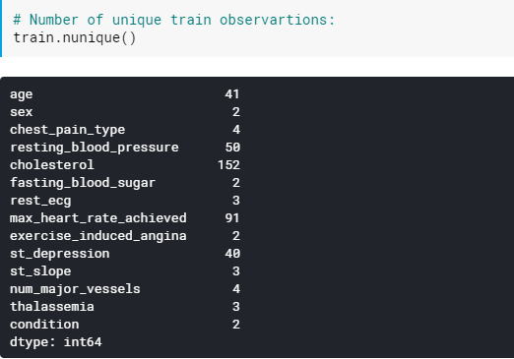
Number of unique train observations

Slide 9
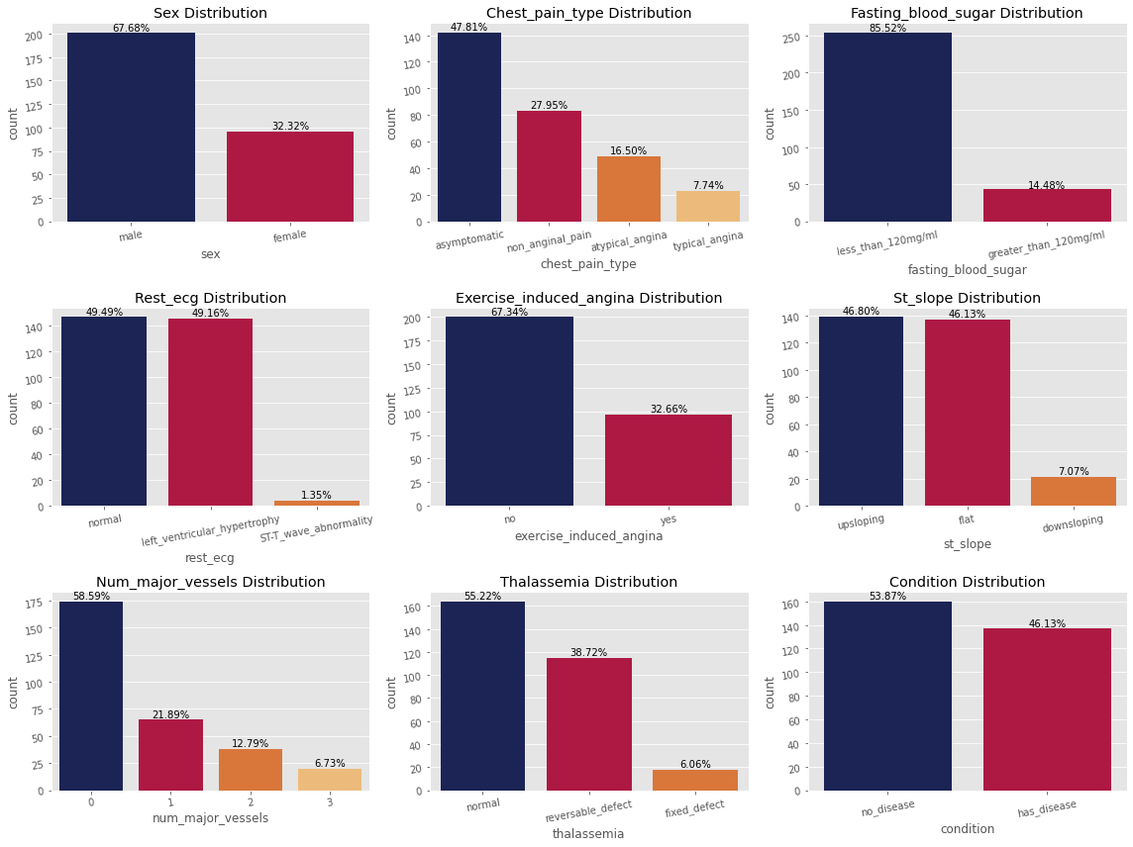
2. Univariate Analysis:
2.1 Categorical data
We going to inspect how's the data distribution is and what patterns we can inspect.

Slide 10

From the chart, we can see :
Males on the dataset is more than double of the female observations.
Most common chest pain type is 'Asymptomatic' ones which is almost 50% of the data
85% of the patients has no high levels of fasting blood sugar.
Resting electrocardiographic observations are evenly distributed between normal and left ventricular hypertrophy with ST-T minority
67% of the patients had no exercise induced angina
Peak exercise slope seems mainly divided between upsloping and flat.

Slide 11
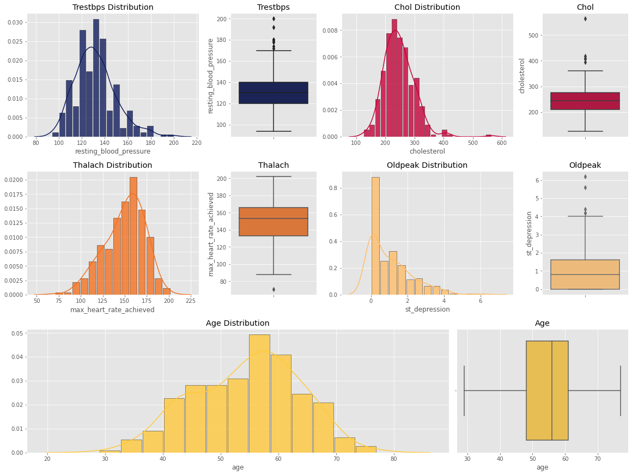
2.2 Numerical data
Most of the continuous variables somewhat close to gaussian distribution with small skews left or right except for oldpeak. Again there are some outliers especially a strong one in Cholesterol .

Slide 12
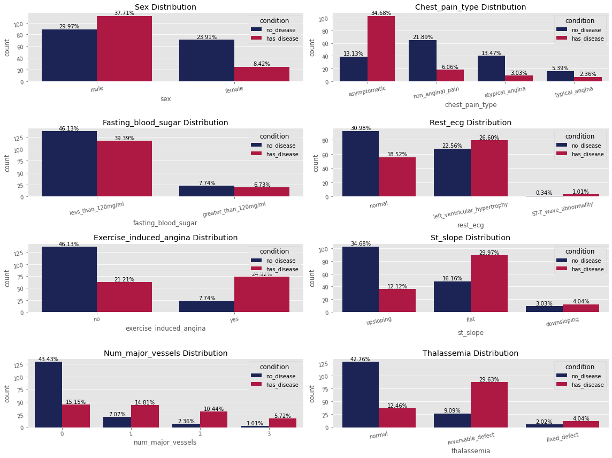
3. Bivariate Analysis
3.1 Categorical Data vs Label

Slide 13
Males are much more likely for heart diseases.
Chest pain type is very subjective and has no direct relation on the outcome, asymptomatic chest pains having highest disease outcome.
Blood sugar has no direct effect on the disease.
Rest ECG results showing no direct results but having normal ECG is pretty good sign. Even though it's pretty rare in the data, if you ST-T wave abnormality you are 3 times more likely to have heart disease.
Having exercise induced angina is pretty strong indicator for heart disease, patients are almost 3 times more likely to have disease if they have exercise induced angina. Meanwhile it's less than half for not having it.
Patients who had flat slope distribution are more likely to have disease.
Number of major vessels observed seems on similar levels for patients who have disease but 0 observations is good sign for not having disease.
Having defected thallium test results is pretty strong indicator for heart disease.

Slide 14
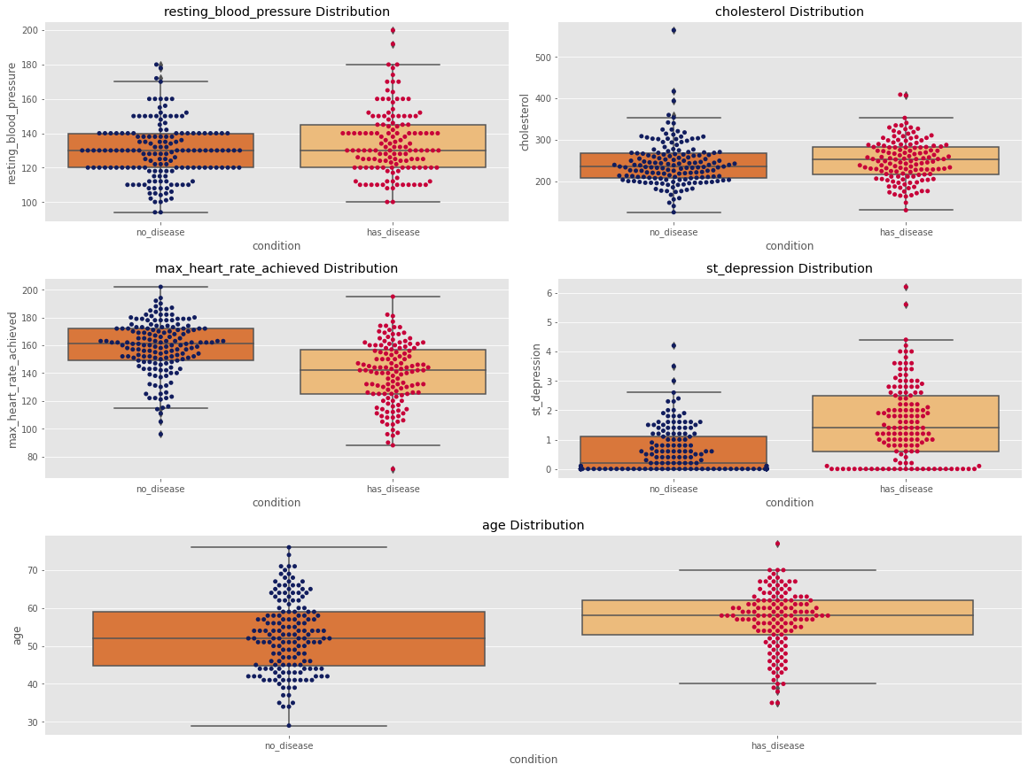
3.2 Numerical Data vs Label

Slide 15
Having higher resting blood pressure shows you are little bit more likely to have heart disease.
Again same for Cholesterol, it's not strong indicator but patients are little bit more likely to have disease with high cholesterol. There's is also one outlier there with no disease, pretty interesting.
I find max heart rate distribution a bit interesting, expecting the other way around but it might be due to testing conditions and if you have normal results on ECG while exercising instructors might be increasing your exercise density?
It's pretty clear that heart disease likelihood increases with ST depression levels...
Lastly older patients are more likely to have heart disease.

Slide 16
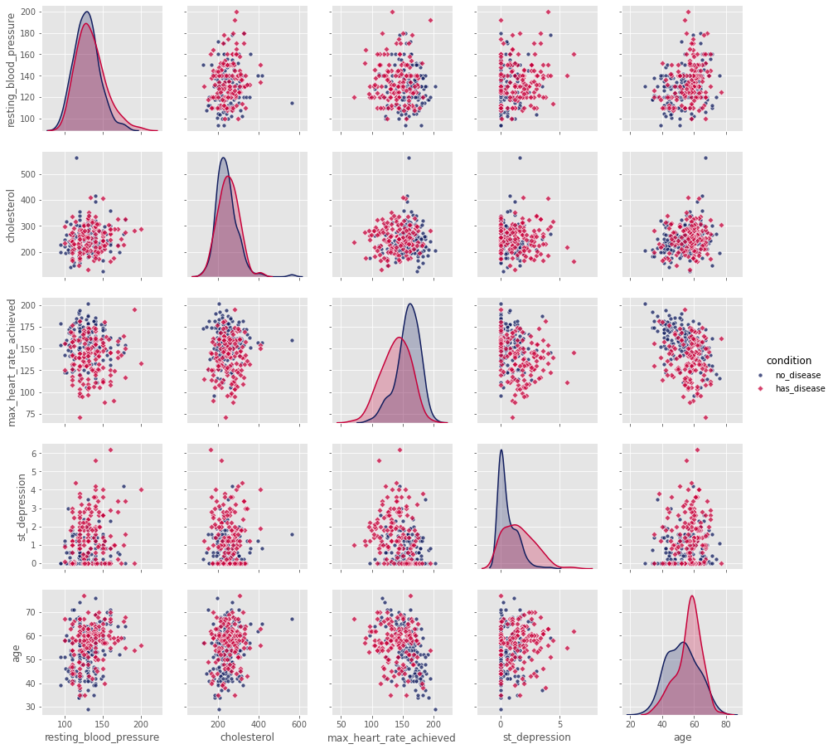
4. Multivariate Analysis
We take our variables and compare them against our target condition which is if the observed patient has disease or not.

Slide 17
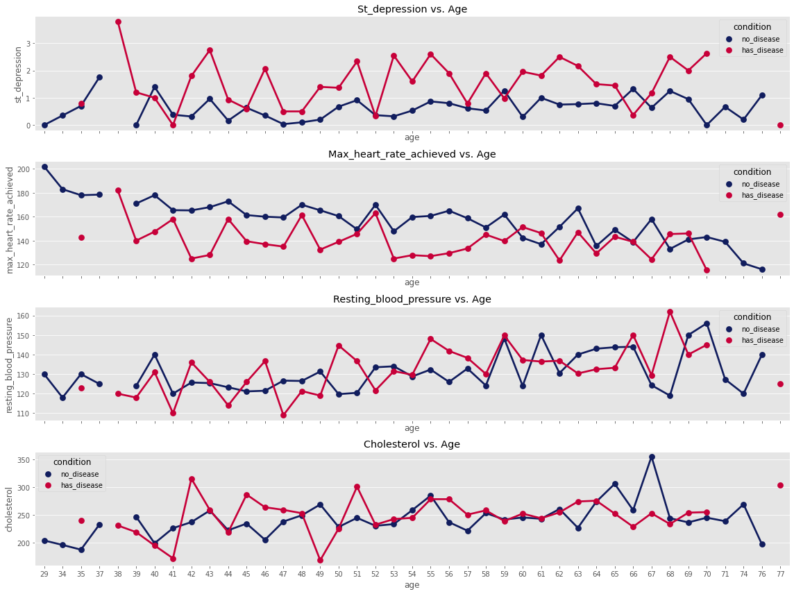
Inspecting Age Closer

Slide 18
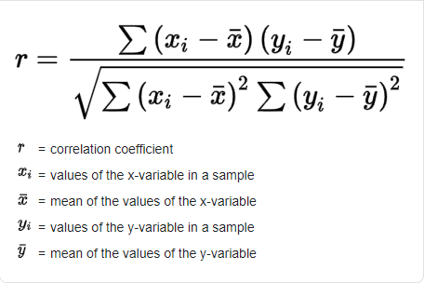
5. Correlations
We’re going to use Pearson correlation for to find linear relations between features, heatmap is decent way to show these relations.
Here is a calculation formula for Pearson correlation :

Slide 19
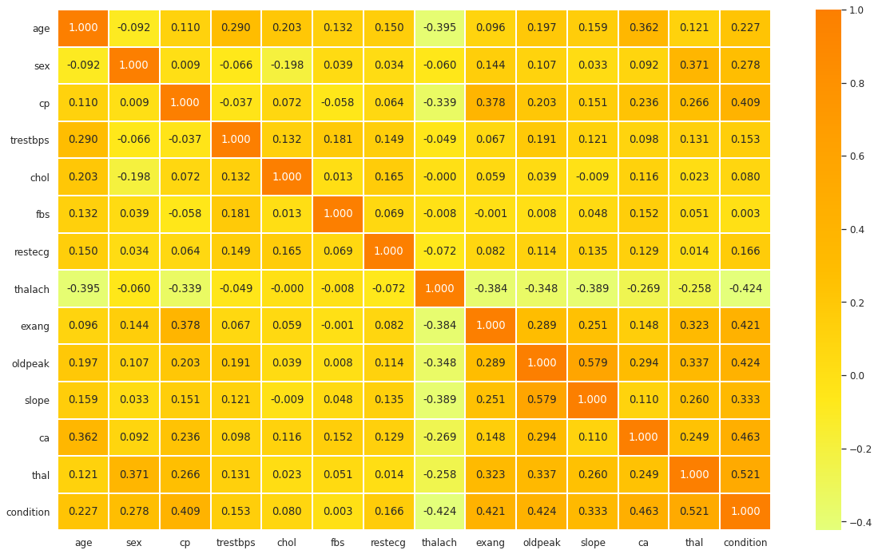
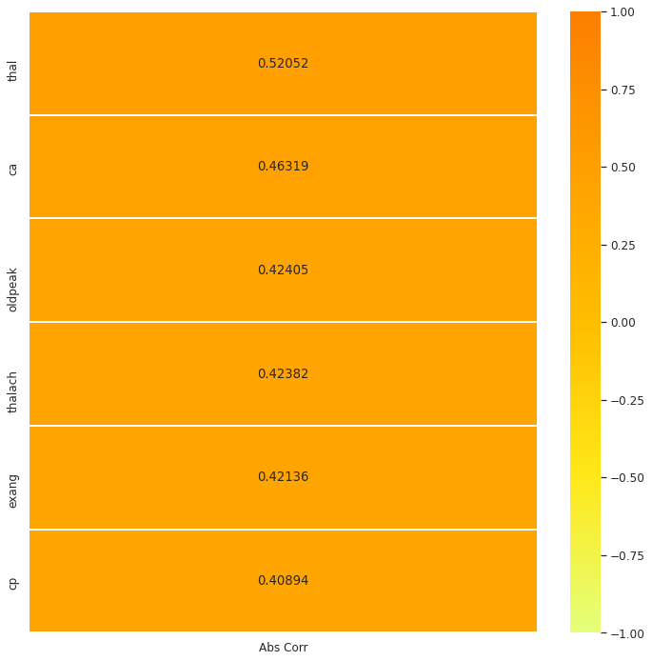
⇒ Thal is the most correlated.

Slide 20


II. Modelling

Slide 21
Classifiers
This is a Classification problem: Has Heart Disease or Not
There are some algorithms that we can use to tackle this stuff, but on this topic we’ll choose Support Vector Machine (SVM), Naive Bayes, Logistic Regression and Decision Tree.
With these four algorithms, we will apply them to this dataset using scikit-learn library and other tools that could improving their performance.
❓ What could be the best algorithm for this sort of dataset?

Slide 22
1.1 Support Vector Machines
Support vector machines (SVMs) are a set of supervised learning methods used for classification, regression and outliers detection.
- The advantages of support vector machines are:
+ Effective in high dimensional spaces.
+ Still effective in cases where number of dimensions is greater than the number of samples.
+ Uses a subset of training points in the decision function (called support vectors), so it is also memory efficient.
+ Versatile: different Kernel functions can be specified for the decision function. Common kernels are provided, but it is also possible to specify custom kernels.

Slide 23
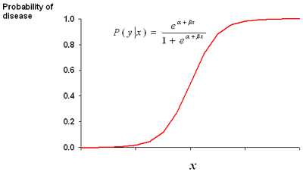
1.2 Logistic Regression
Logistic regression is the appropriate regression analysis to conduct when the dependent variable is dichotomous (binary). Like all regression analyses, the logistic regression is a predictive analysis.
Logistic regression is used to describe data and to explain the relationship between one dependent binary variable and one or more nominal, ordinal, interval or ratio-level independent variables.

Slide 24
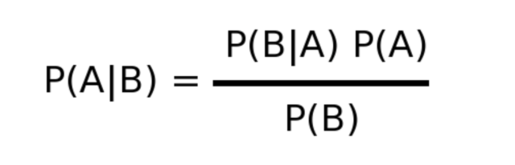
1.3 Naive Bayers
Naive Bayes is a simple learning algorithm that utilizes Bayes rule together with a strong assumption that the attributes are conditionally independent, given the class.
While this independence assumption is often violated in practice, naive Bayes nonetheless often delivers competitive classification accuracy. Coupled with its computational efficiency and many other desirable features, this leads to naïve Bayes being widely applied in practice.

Slide 25
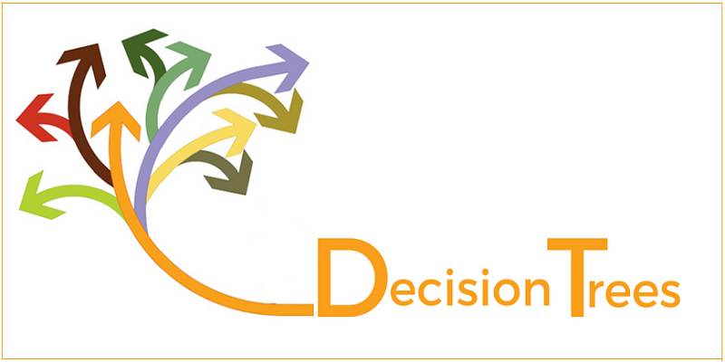
1.4 Decision Tree
Decision Trees (DTs) are a non-parametric supervised learning method used for classification and regression.
The goal is to create a model that predicts the value of a target variable by learning simple decision rules inferred from the data features.
Decision trees learn from data to approximate a sine curve with a set of if-then-else decision rules. The deeper the tree, the more complex the decision rules and the fitter the model.

Slide 26
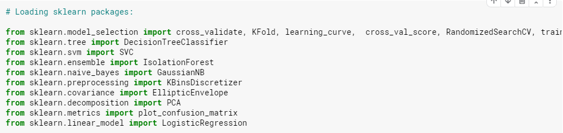
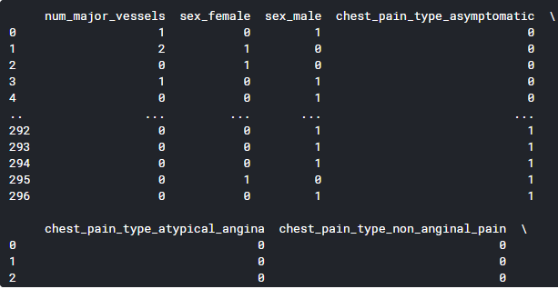
2. Import libraries, preprocessing data and training.
Use one hot encoding for categorical data:

Slide 27
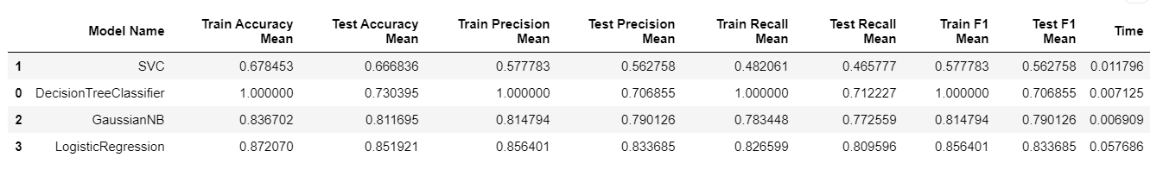
3. Baseline Results
Sort by F1 score
SVC has the lowest score -> Can we improve it?
Decision Tree Classifier is overfitting -> Can we get rid of it?

Slide 28
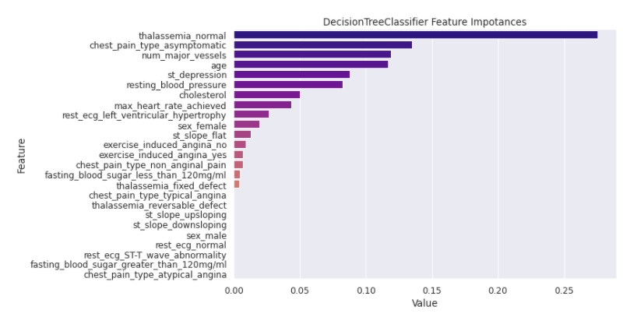
Since our decision tree based model overfitting, we wanted to look which features are most affected these decisions. We sampled the tree based model which you can see as a diagram below:

Slide 29
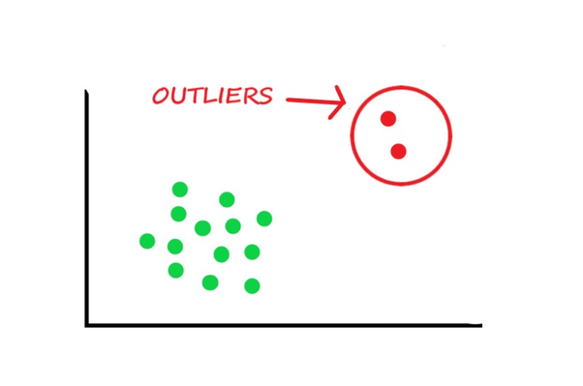
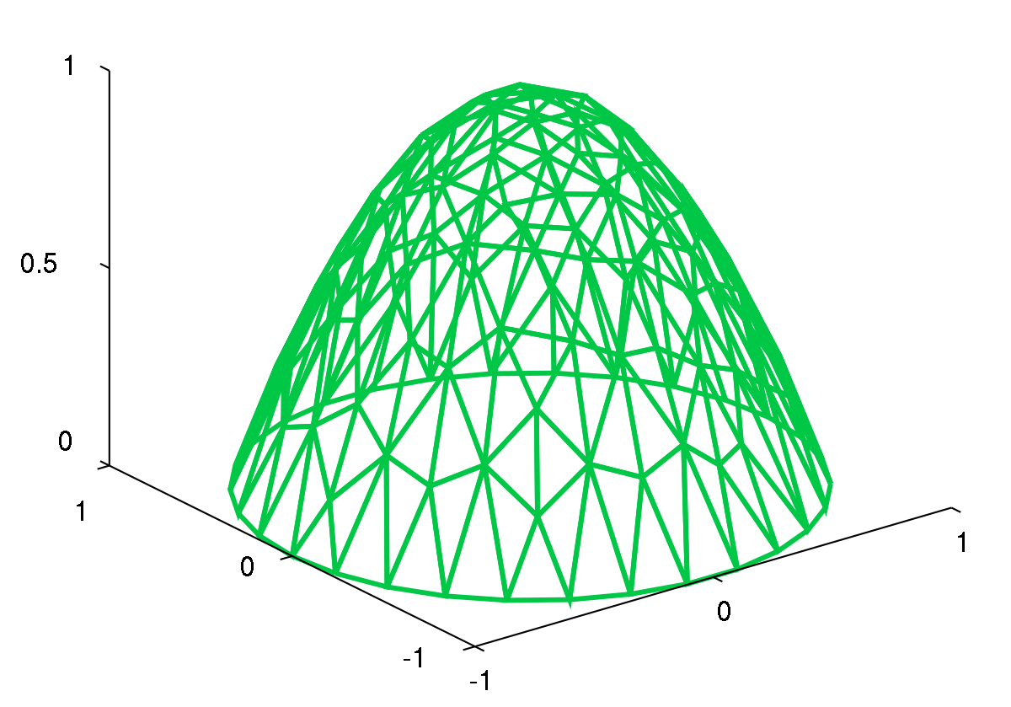
4. Model tuning
4.1 Preprocess the data set before tuning: Before going to tune our models, we decided to preprocess the dataset like get rid of outliers, discretization,...

Slide 30
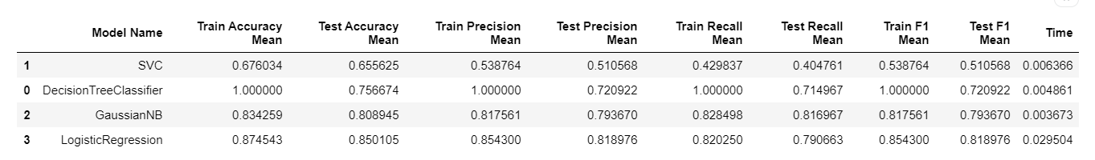
4.1.1 Isolation Forest
The Isolation Forest ‘isolates’ observations by randomly selecting a feature and then randomly selecting a split value between the maximum and minimum values of the selected feature.
Below is our result, it’s not get very well then...

Slide 31
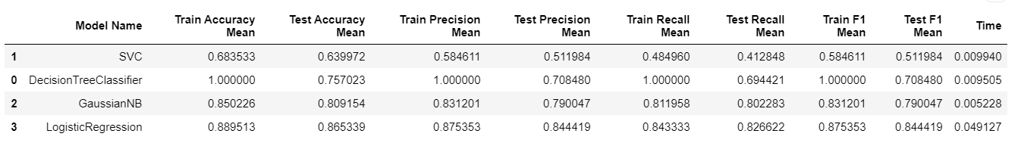
4.1.2 Elliptic Envelope
Let’s use another tools. We assumed our distribution close to gaussian while inspecting the data so elliptic envelope worth to take a look.
The Minimum Covariance Determinant (MCD) method is a highly robust estimator of multivariate location and scatter, for which a fast algorithm is available. […] It also serves as a convenient and efficient tool for outlier detection.
Below is our result, this one did a little bit better than Isolation Forest so let's stick with it for this case...

Slide 32
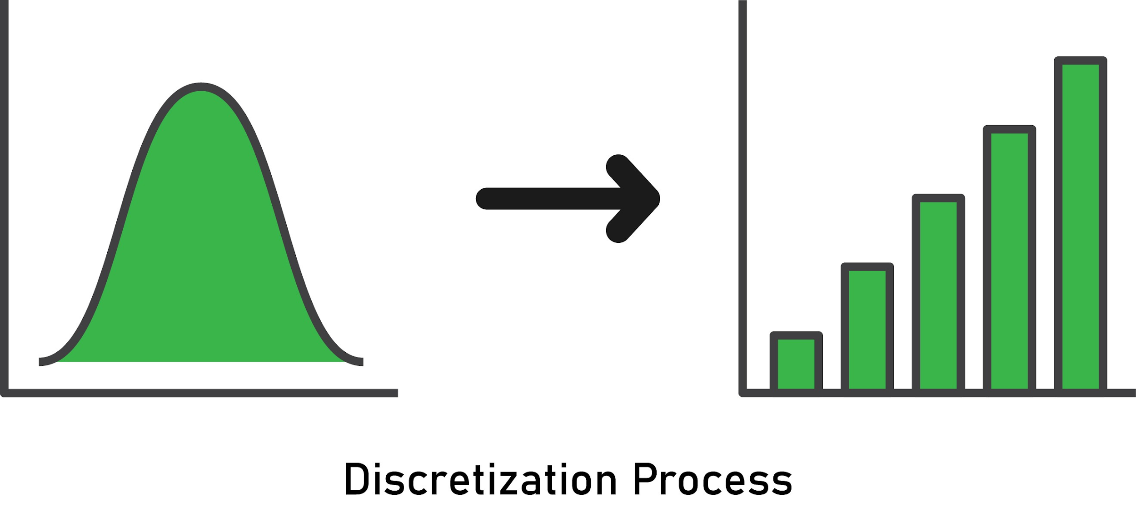
4.1.3 Discretization
Discretization (otherwise known as quantization or binning) provides a way to partition continuous features into discrete values. Certain datasets with continuous features may benefit from discretization, because discretization can transform the dataset of continuous attributes to one with only nominal attributes.

Slide 33
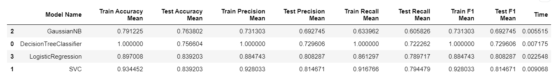
K-Bbins Discretization: This method discretizes features into 'k' bins. Sklearn module takes several strategy parameters but we going to use 'kmeans' strategy which defines bins based on a k-means clustering procedure performed on each feature independently
Below is our result, seems like binning improved models a little bit. Especially, it gives SVC a huge boost
SVC's score seems better now
Decision Tree Classifier still overfitting

Slide 34
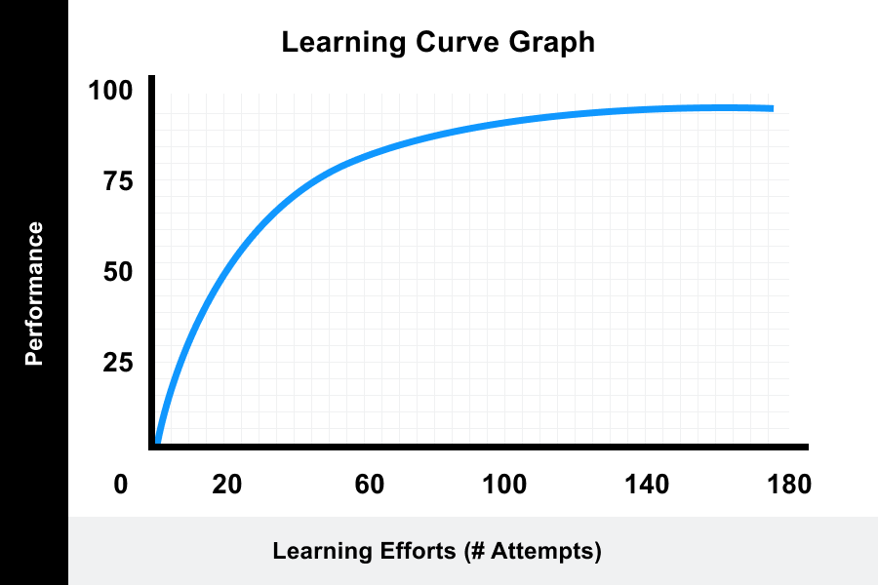
4.2 Plot the models learning process: Learning Curve
Learning Curve can show us how fast the models learning and especially how is the model doing with the number of data given so we can decide if more data needed for better results.

Slide 35
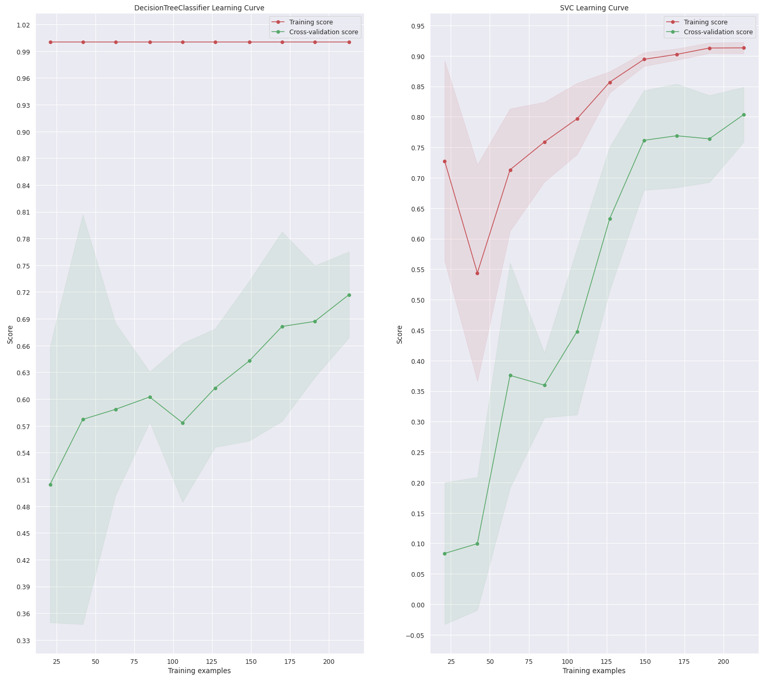

Slide 36
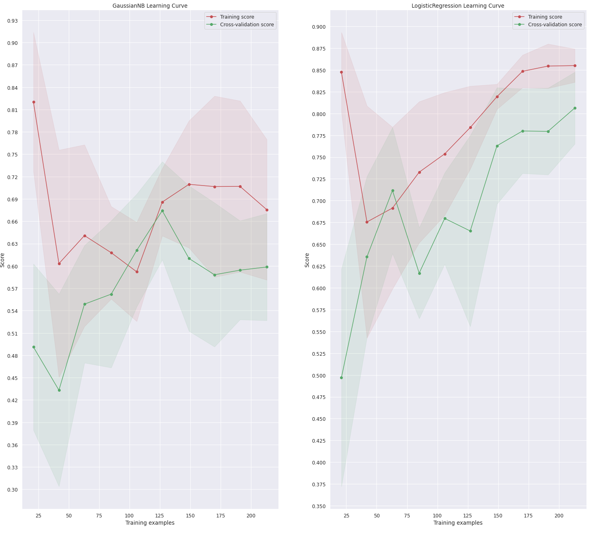
➥ We can see that model using Decision Tree is still overfitting and the rest of our models get better with more data.

Slide 37
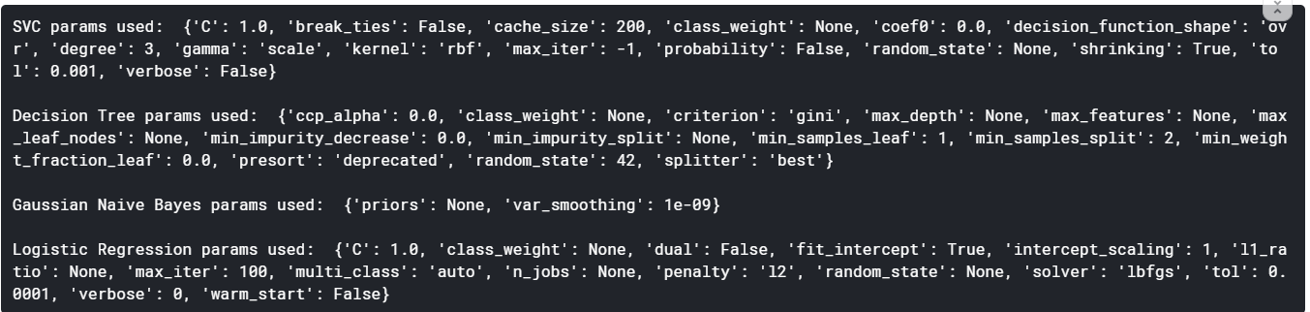
4.3 Fine tune our models: RandomizedSearchCV
Let's get rid of overfitting, one of the easiest ways of doing it is tuning parameters for our estimators and regularize them. For example, with all of parameters below we are using on Decision Tree model, we can actually choose some of them and tune it to find the best for our model.
First we will consider all the parameters we used for previous models:

Slide 38
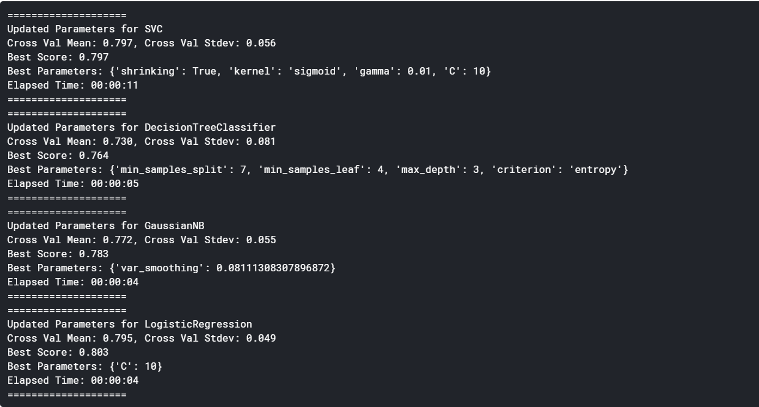

Slide 39
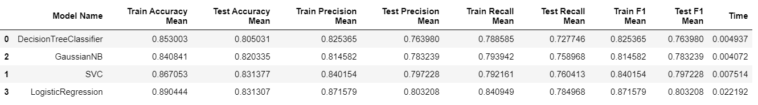
Tuned Model Results

Slide 40
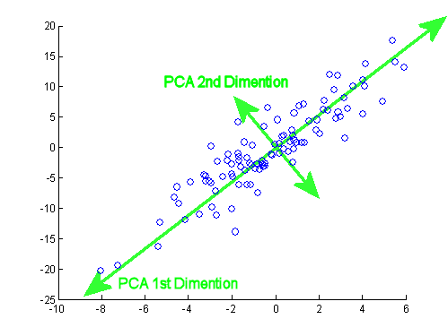
5. Dimension Reduction Using PCA
PCA is used to decompose a multivariate dataset in a set of successive orthogonal components that explain a maximum amount of the variance.
Reducing dimensions is useful for bigger datasets because by transforming a large set of variables into a smaller one that still contains most of the information in the large set makes your modelling faster.

Slide 41
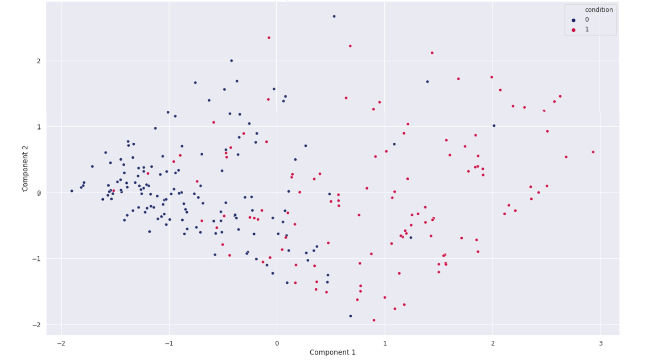

Slide 42
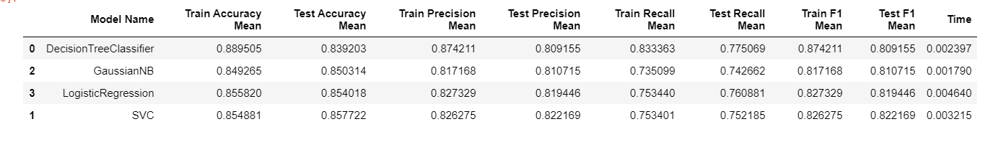
Reduced Dimension Model Results with PCA=2

Slide 43
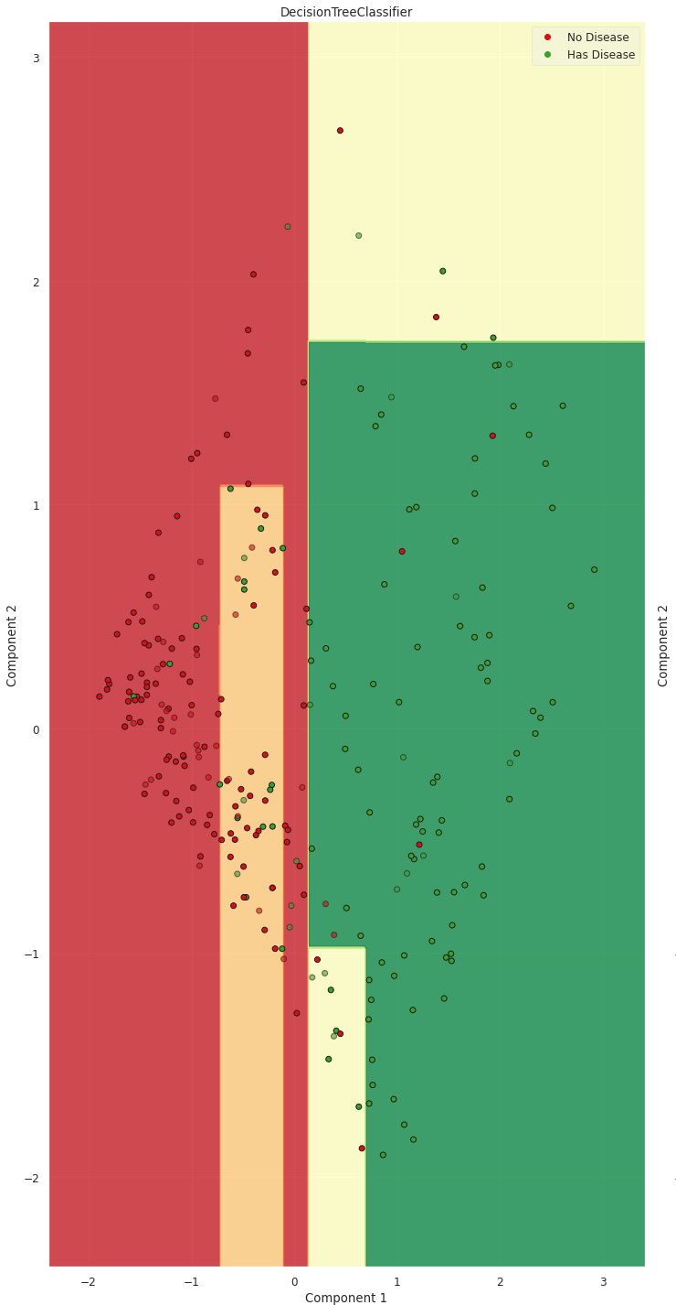
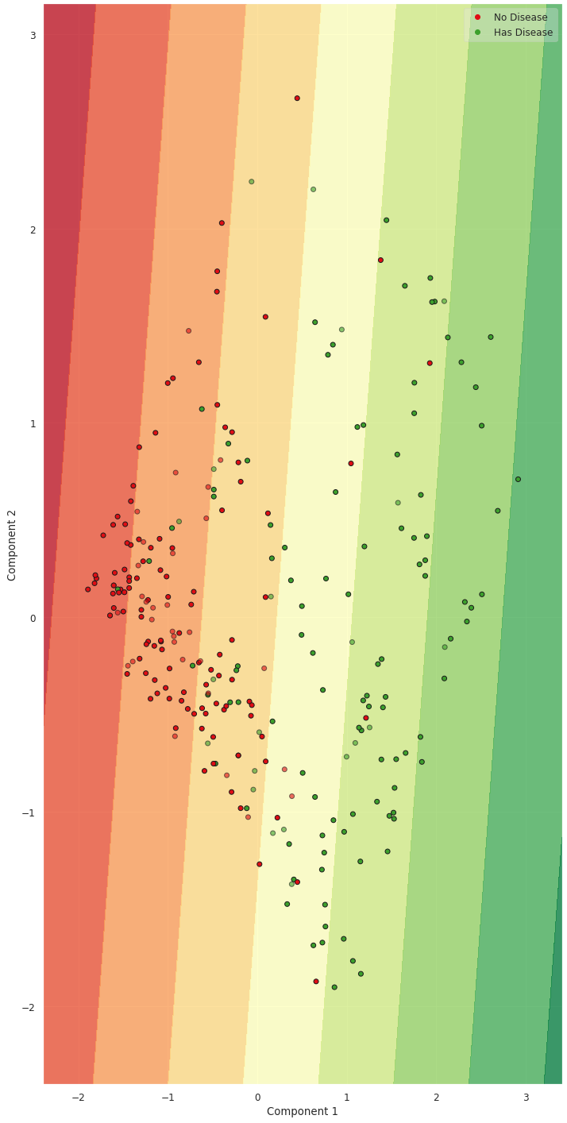
6. Decision Regions
DecisionTreeClassifier SVC

Slide 44
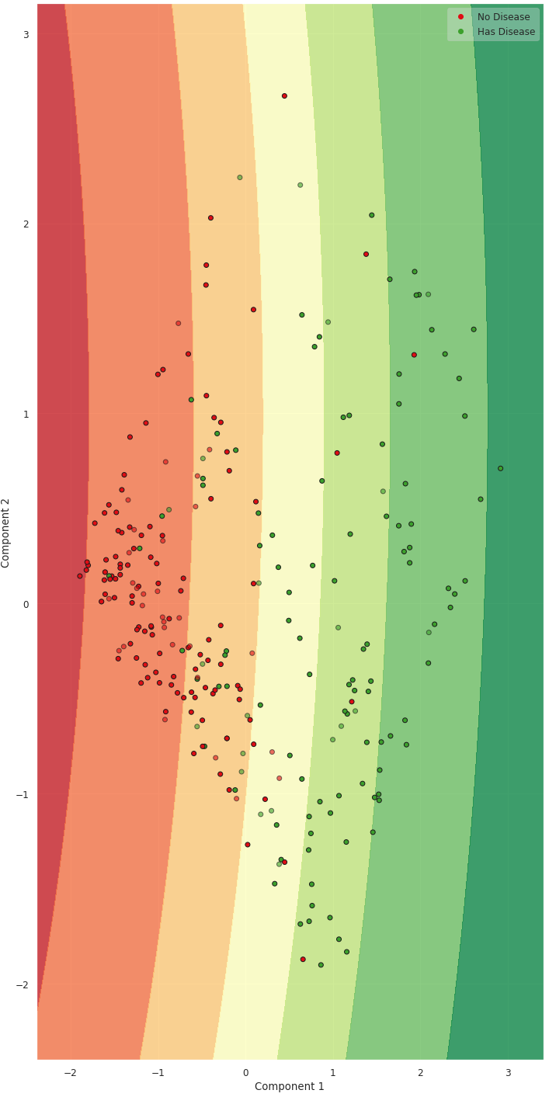
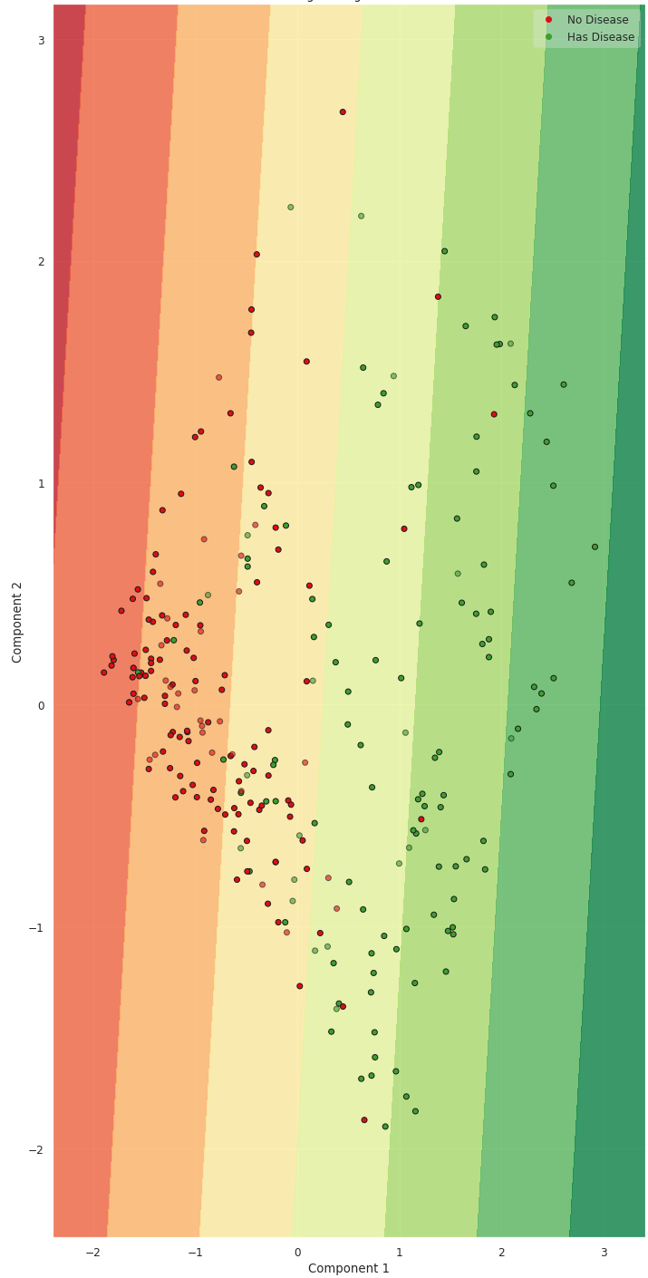
Naive Bayes Logistic Regression

Slide 45
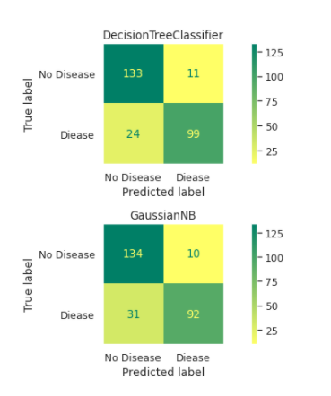
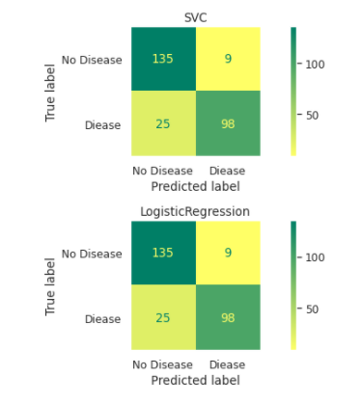
7. Confusion Matrix

Slide 46
III. Conclusion: What we can learn after tackling this dataset?
With the previous data analysis, we can briefly conclude that thal and age are both the good indicators to decide if the patient has heart disease or not.
Moreover, as seen in the final Model prediction results table, we could says that the SVM and Logistic Regression model is somewhat working well on this dataset based on their accuracy on the test set.

Slide 47
References
[1] Heart Disease Cleveland UCI | Kaggle
[2] Heart Disease UCI | Kaggle | Discussion | The ultimate guide to this dataset!
[3] Heart Disease and Some scikit-learn Magic | Kaggle

Slide 48


